Slide 1
Gold Particle on a Titania Surface
By Ely Farrés Palomeras (1637869)
With HEAVY contributions from Jordi Faraudo

Slide 2
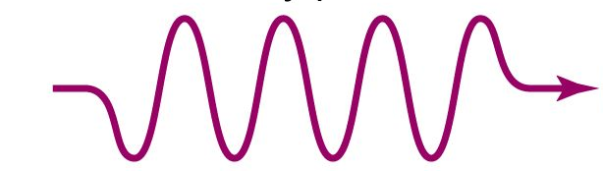
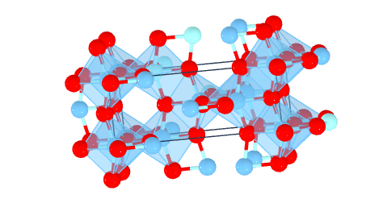
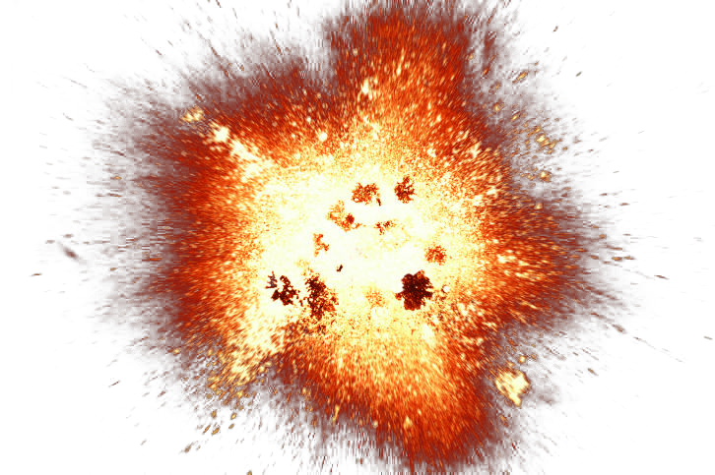
Project Idea
e-
h+

Slide 3
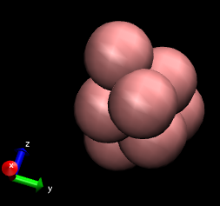
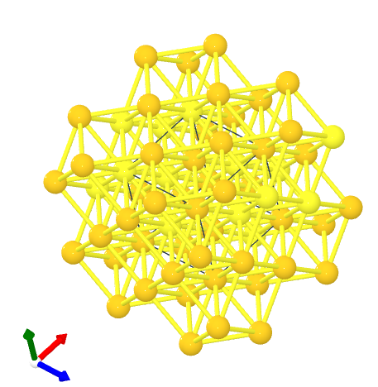

Gold Nanoparticle
Au from The Materials Project

Slide 4
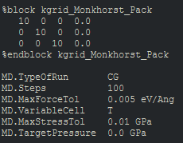
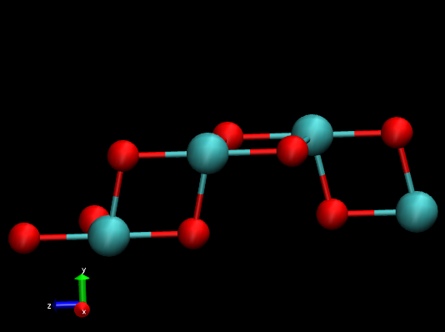
Anatase Basis
Anatase from
The Materials Project

Slide 5
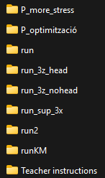
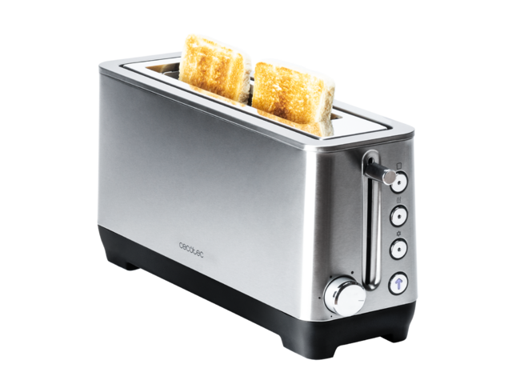

Everything starts to go wrong
Each of this is like 5 simulations average

Slide 6



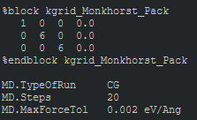
Everything starts to go wrong

Slide 7
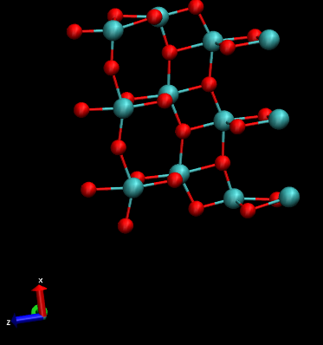
Anatase Surface
3 cells in x

Slide 8
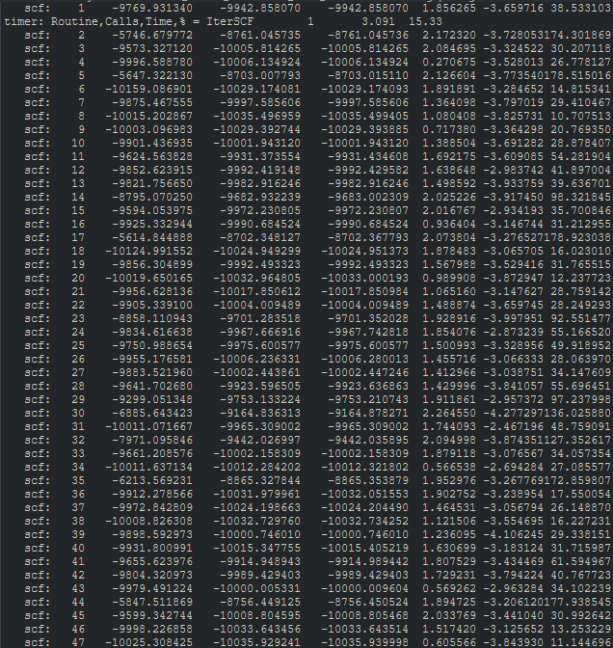
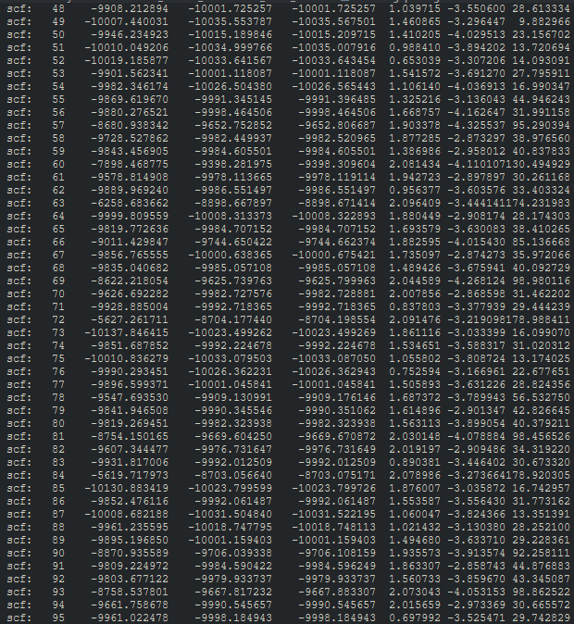
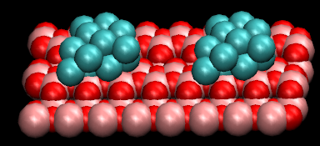
Surface With Particle

Slide 9
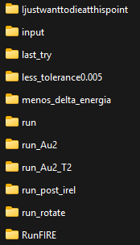
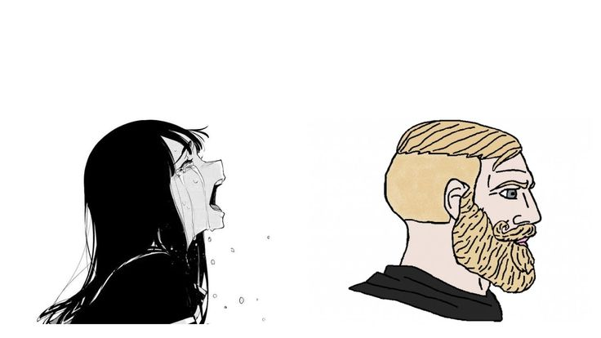

AAAAAAAAAAAAAAAAAAAAAAAAAHHHHHHHHHHHHHHHH
Please converge!!
Jeje… no

Slide 10

AAAAAAAAAAAAAAAAAAAAAAAAAHHHHHHHHHHHHHHHH
IAMDEFEETED

Slide 11
11 h 30 min

Slide 12
11 h 30 min
Erm…
Gold Nanoparticles Optical Propeties
I guess…

Slide 13
11 h 30 min
Plan
Make particles with 1 to 12 atoms
Look at Plasmonic effect with optical’ and find the gaps

Slide 14
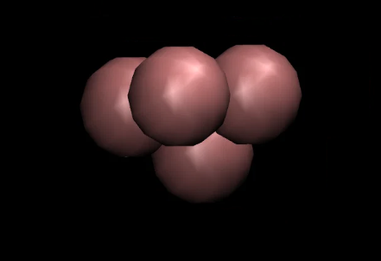
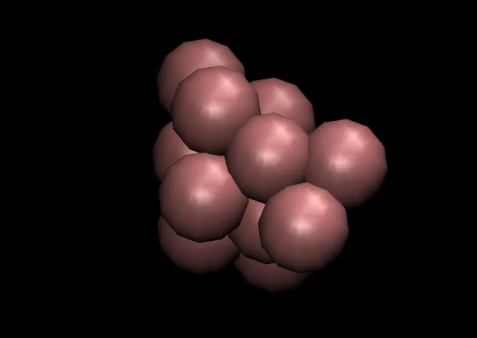
10 h 00 min
Au Nanoparticle
Initial files generated with a Python script
A lot of free space in every direction

Slide 15
9 h 15 min
Au Nanoparticle
From 8 forward they stoped converging
Used each result structure to generate the next particle input

Slide 16
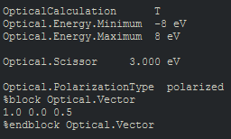
9 h 00 min
Optical propeties

Slide 17

9 h 00 min
Optical propeties

Slide 18
7 h 00 min
I fail yet again
W R O N G
Optical information

Slide 19

7 h 00 min
I fail yet again
Should have occupancy of the bands
Using .EIG and assuming HOMO is the largest negative
*doesn’t exist*

Slide 20
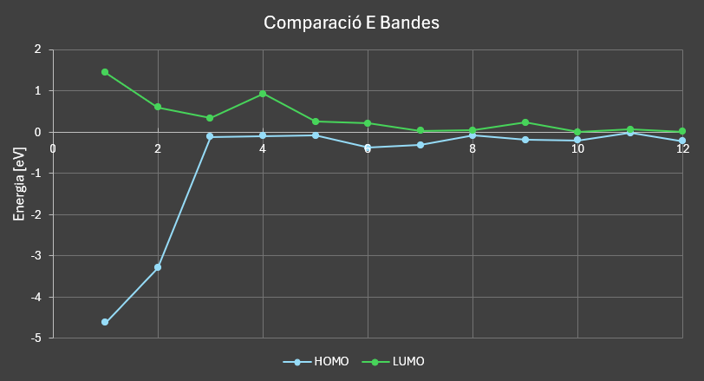
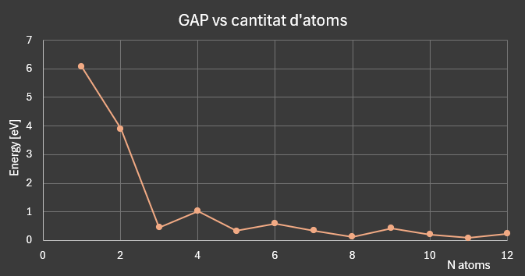
6 h 30 min
Gaps

Slide 21
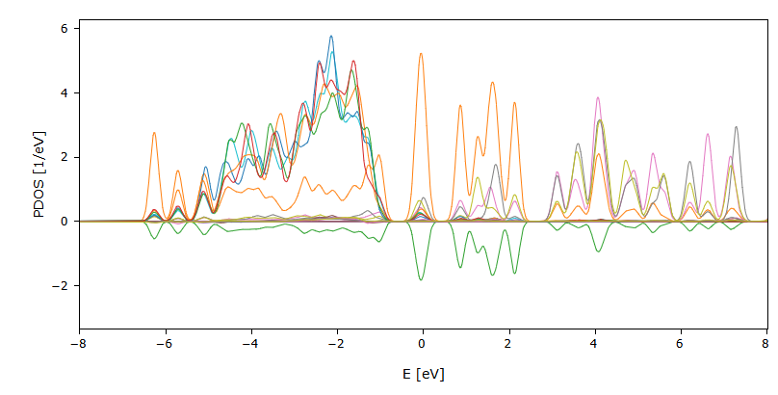
6 h 30 min
Gaps

Slide 22
I was unable to
6 h 00 min
Use Optical’
Reads the .EPSIMG and generates an e2.dat input
Gives you the reflectance and the refractive index

Slide 23
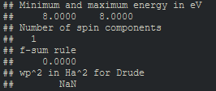
I was unable to
6 h 00 min
Use Optical’
Reads the .EPSIMG and generates an e2.dat input
Gives you the reflectance and the refractive index
The .EPSIMG in question

Slide 24
5 h 00 min
WHY WON’T THIS WORK
What do you mean NaN?

Slide 25
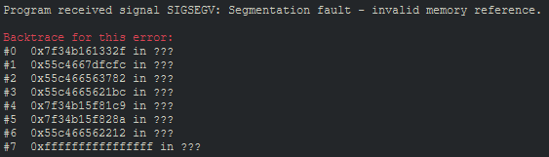
4 h 30 min
WHY WON’T THIS WORK
What is a SIGSEGV?????

Slide 27
Conclusion
IAMDEFEETED yes, again

Slide 28
please don’t ask questions

